Slide 1
SUGCON EUROPE 2024 Highlights
Sumit Upadhyay
11-May-2024

Slide 2
Agenda
Introduction
SUGCON: What and Why?
SUGCON Europe 2024 Agenda
Dave O’Flanagan Keynote
Key Takeaways
Resources
Q & A
Thank you!

Slide 3
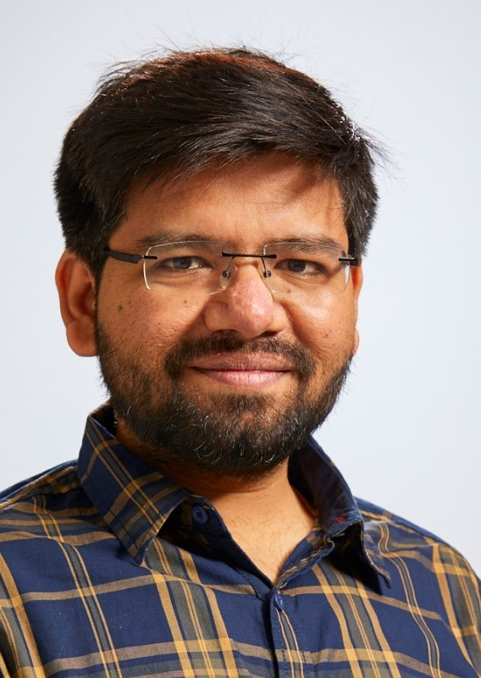
Introduction
Sumit Upadhyay
Software Engineer at Iquality
11+ years of IT Experience
Sitecore MVP Technology 2024
Sitecore, .NET, Azure
Sitecore 8, 9, 10 Certified

Slide 4
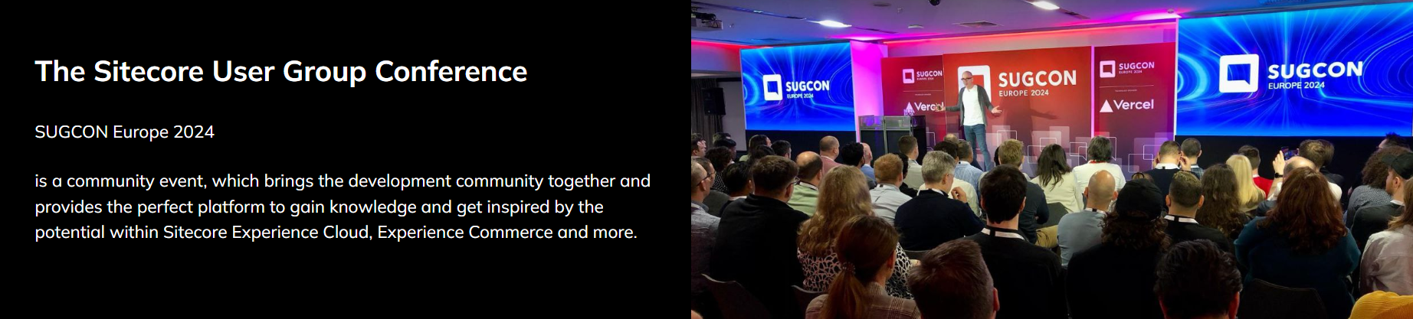
SUGCON

Slide 5

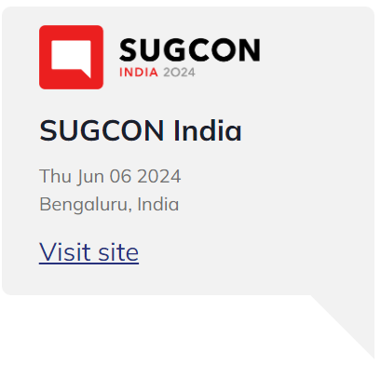
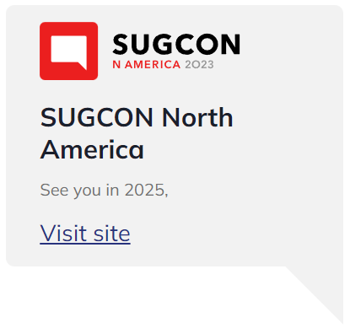
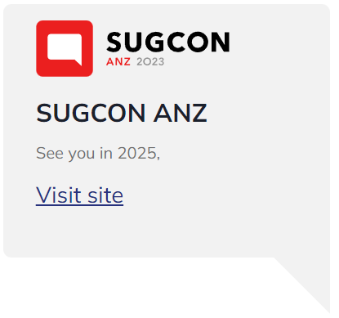
SUGCON

Slide 6
Why Attend SUGCON?
A community event
Great Sessions
Technical and Marketing Tracks
CEO Keynote
Roadmap insights
Networking

Slide 7
SUGCON 2024 Agenda

Slide 8
Keynote from Dave

Slide 9
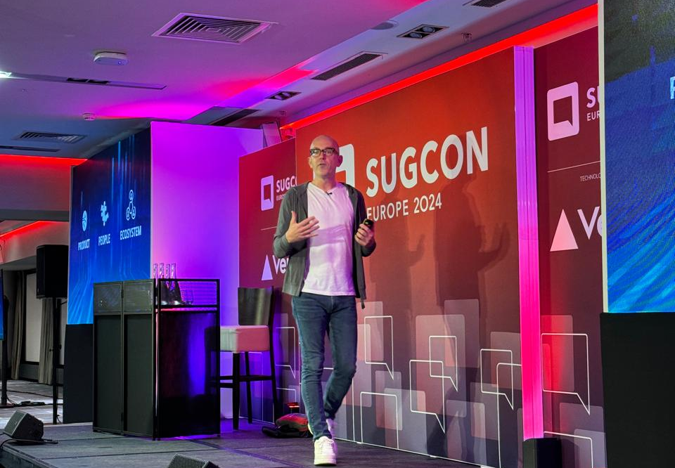
Keynote
XM/XP going no where!
Product, People and Ecosystem
Simplify, Choice, Innovate
Sitecore 10.4 Announcement
Notes:
As a CEO, his focus will be on Product, People and Ecosystem
Product: invest and make it more stable, xm cloud to be foundation of innovation
People: work with amazing people, unlock to deliver more value
Ecosystem: partnerships, stackexchange, sitecore slack 10000 members
Simplify: entire product, process, pricing, marketing, easier to buy and understand
Choice: customer centric, meet the customer where they want
Innovate: brought composable dxp, xm cloud, very few companies go through this journey successfully

Slide 10
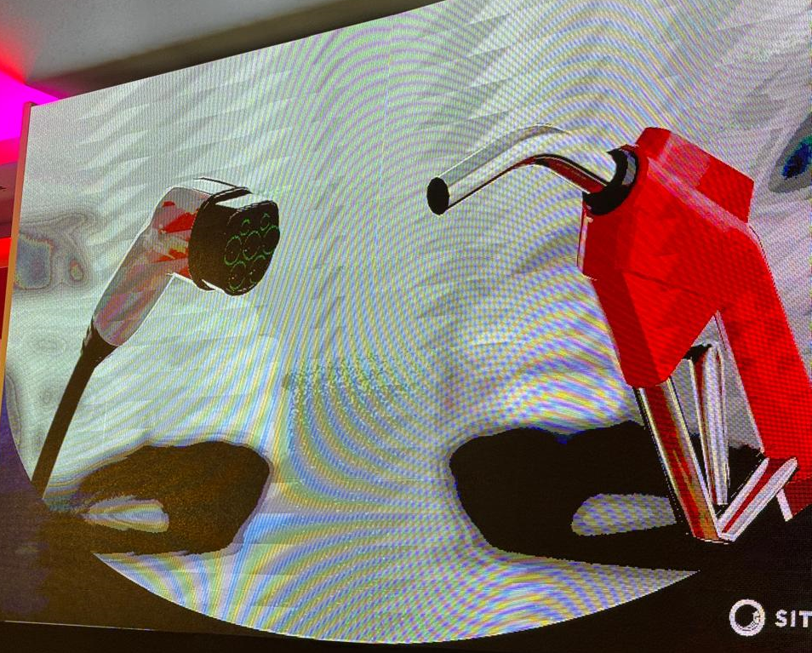
Takeaways
Not everyone wants to move to XM Cloud
More and longer support for DXP
Analogy with Electric and Combustible vehicles
Need of the hour: Hybrid

Slide 11
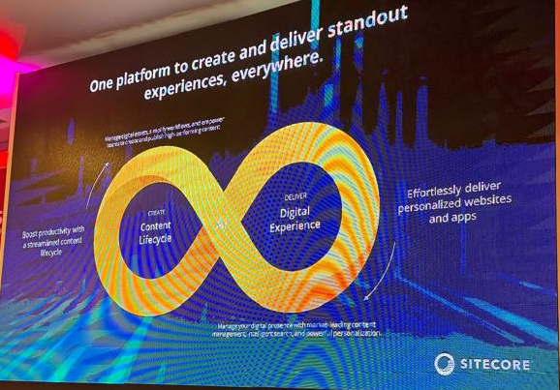
Keynote
Roger Connolly, Sitecore Chief Product Officer (CPO), talked about AI in Sitecore
Include AI in every aspect of the product
Keynote video by Nabil: https://www.youtube.com/watch?v=f_8Fyy6wn8o

Slide 12
Key Takeaways

Slide 13
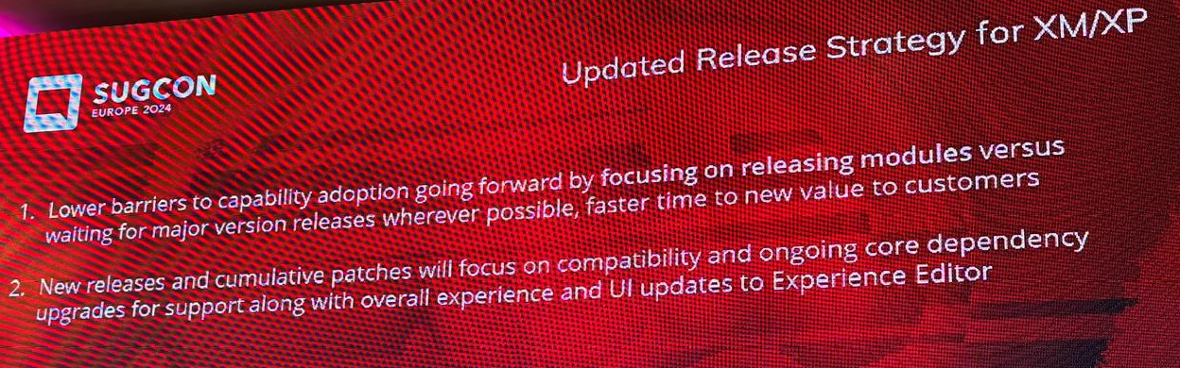
Takeaways: DXP
Updates to be released as Sitecore modules
Faster adoption
No need for full blown upgrade project

Slide 14
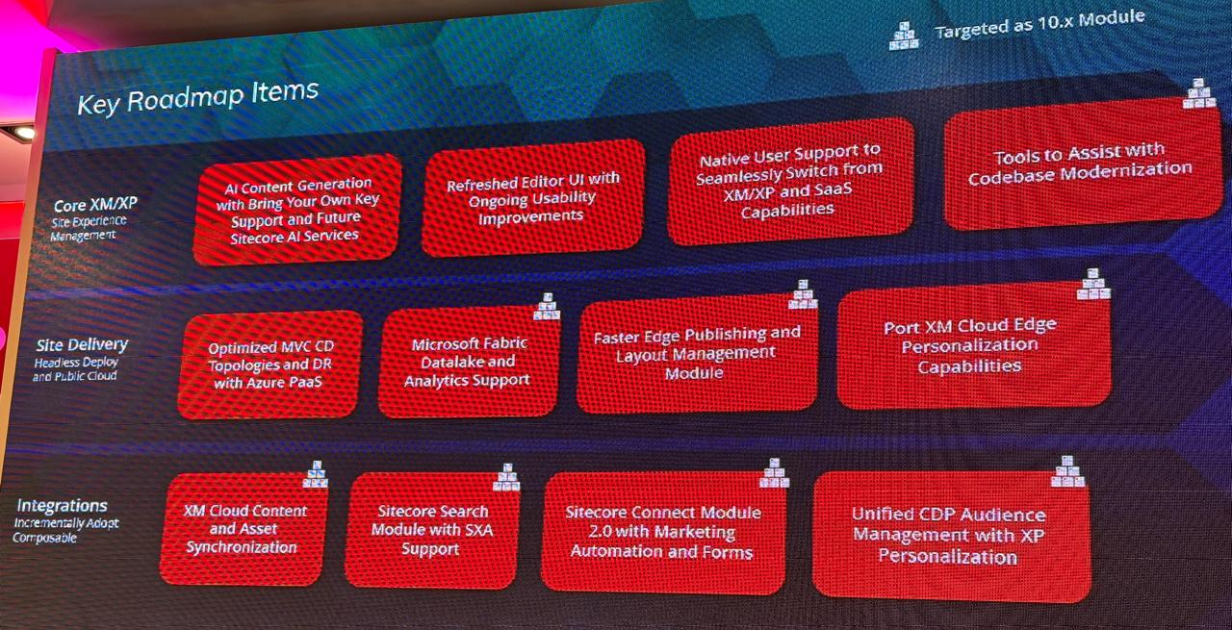
Takeaways: DXP
DXP Roadmap items
Focus on composable integrations
Feature enhancements

Slide 15
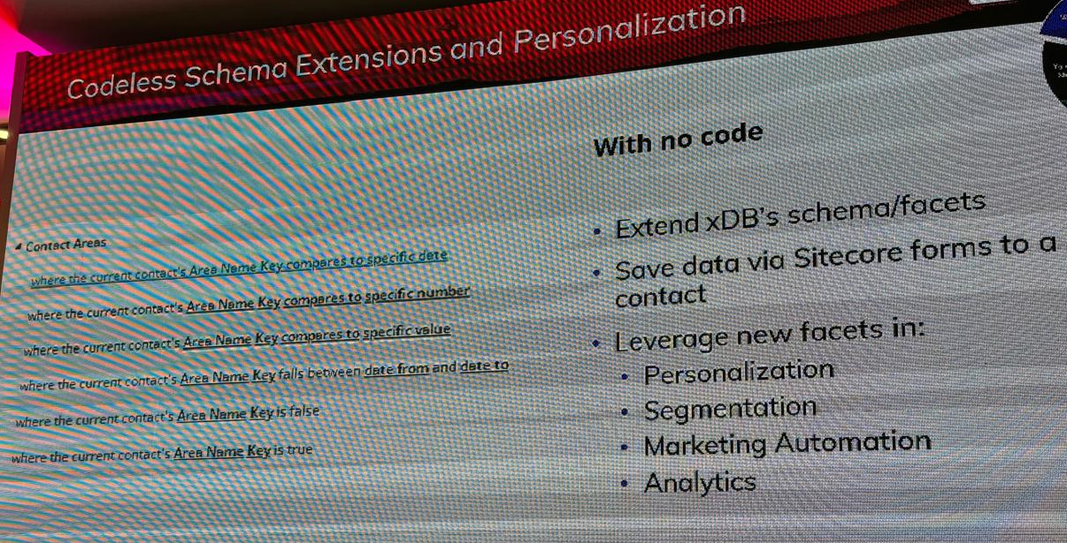
Takeaways: DXP
Codeless Schema Extensions for no code personalization rules
More flexibility when adding personalization rules
Released with 10.4

Slide 16
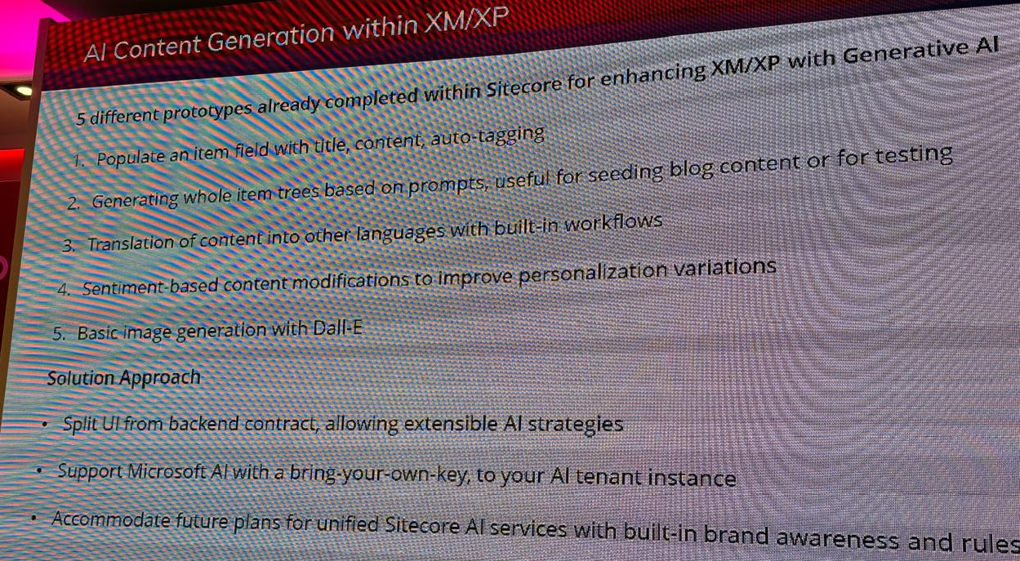
Takeaways: DXP
Lot of work put into integrate AI into the DXP platform
5 AI use cases identified to integrate in the DXP platform
Enabling Bring-your-own-AI in progress

Slide 17
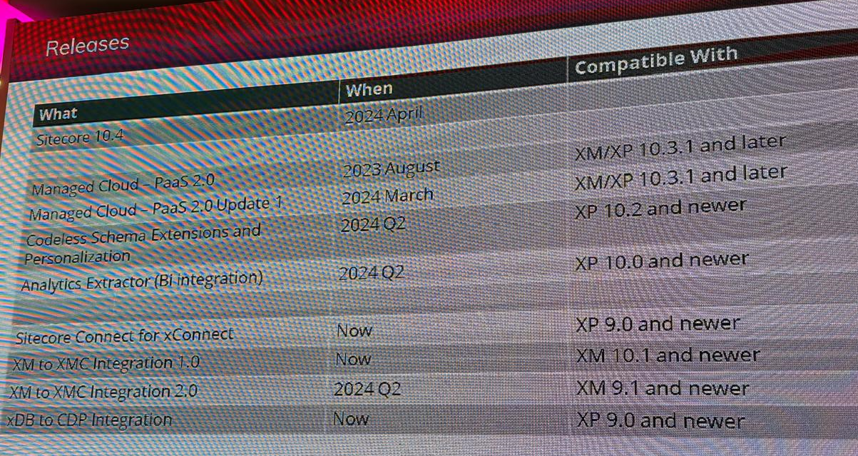
Takeaways: DXP
Release Timeline DXP
Some features to be released for Sitecore 9 as well

Slide 18
Summary
DXP will continue to grow
Making it easier to integrate the SaaS products
Longer version support means no more pushing customers to upgrade
Streamlining the UI with the rest of the product portfolio

Slide 19
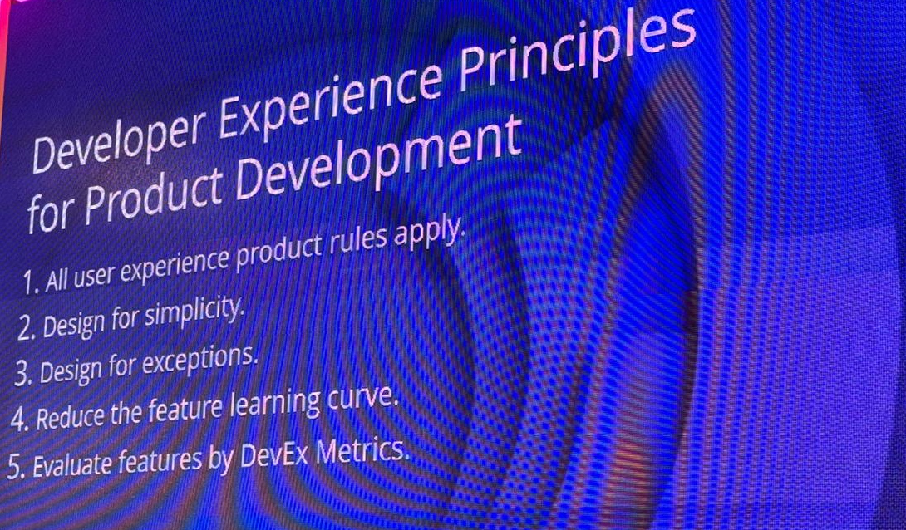
Takeaways: XM Cloud
Improved Developer Experience
Even though Sitecore have released XM Cloud, they are ready to reevaluate it and design it based on these principles

Slide 20
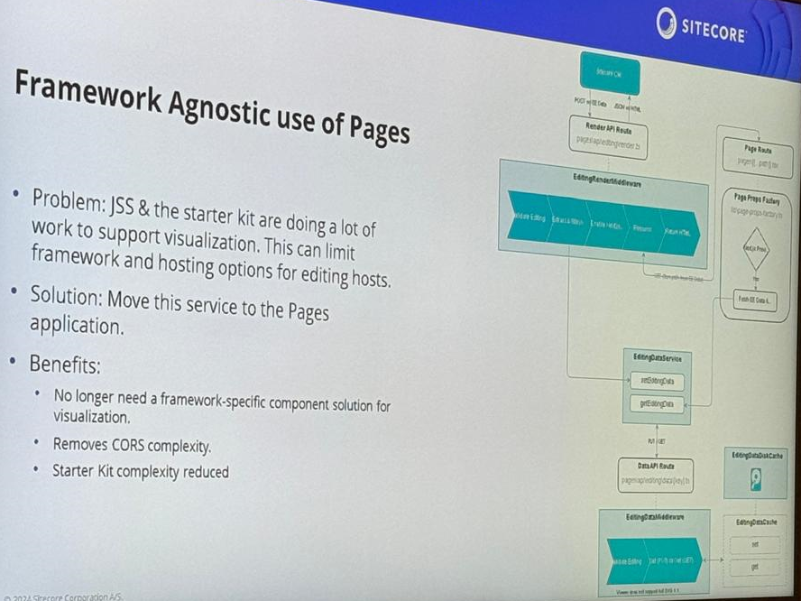
Takeaways: XM Cloud
Move everything into Pages
Provide Framework agnostic way of working
Currently separate code for React, Angular, etc

Slide 21
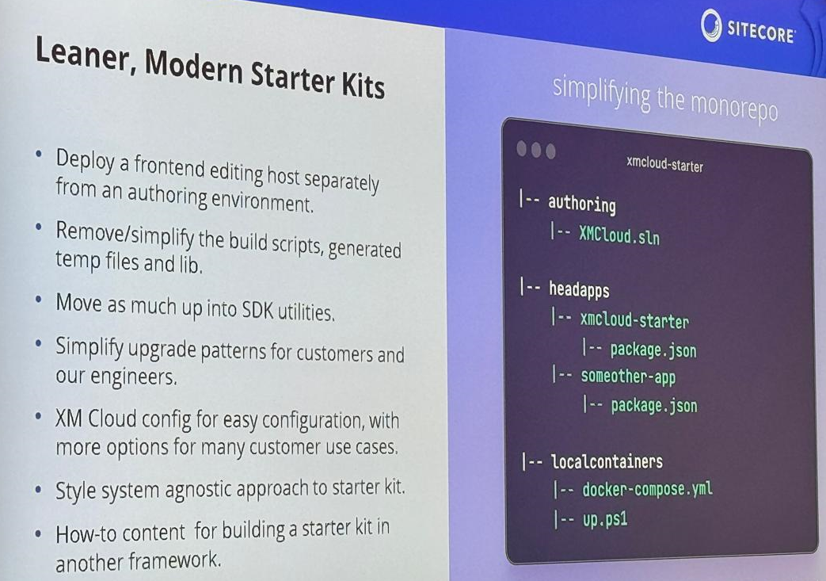
Takeaways: XM Cloud
Simplify the Starter kit for XM Cloud
Move everything into the SDK
Remove upgrade friction

Slide 22
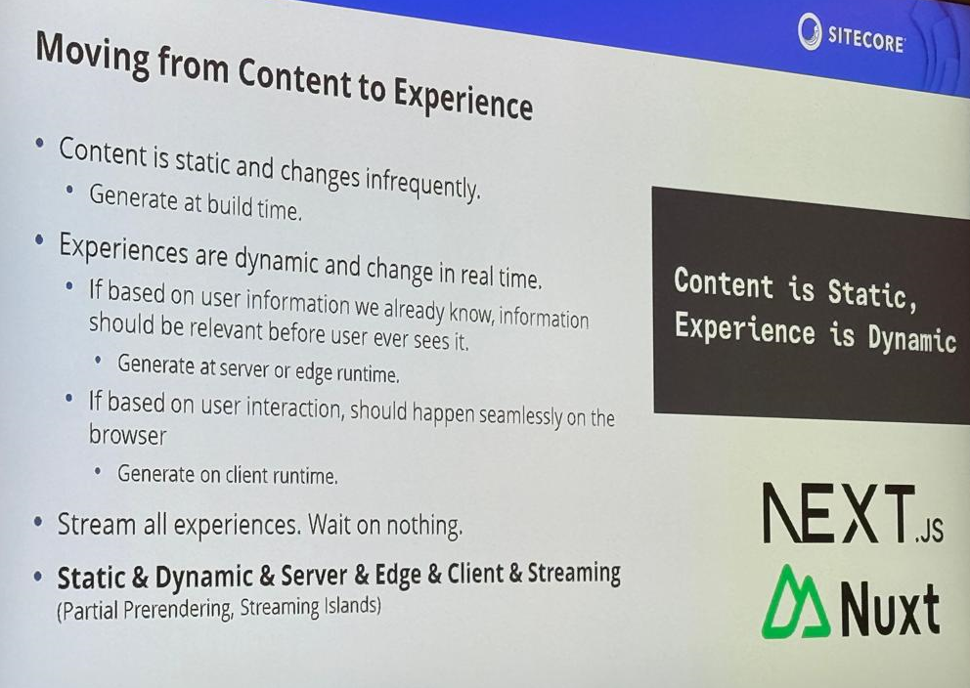
Takeaways: XM Cloud
Making the framework runtime agnostic so that you can run on server runtime, edge runtime, etc

Slide 23
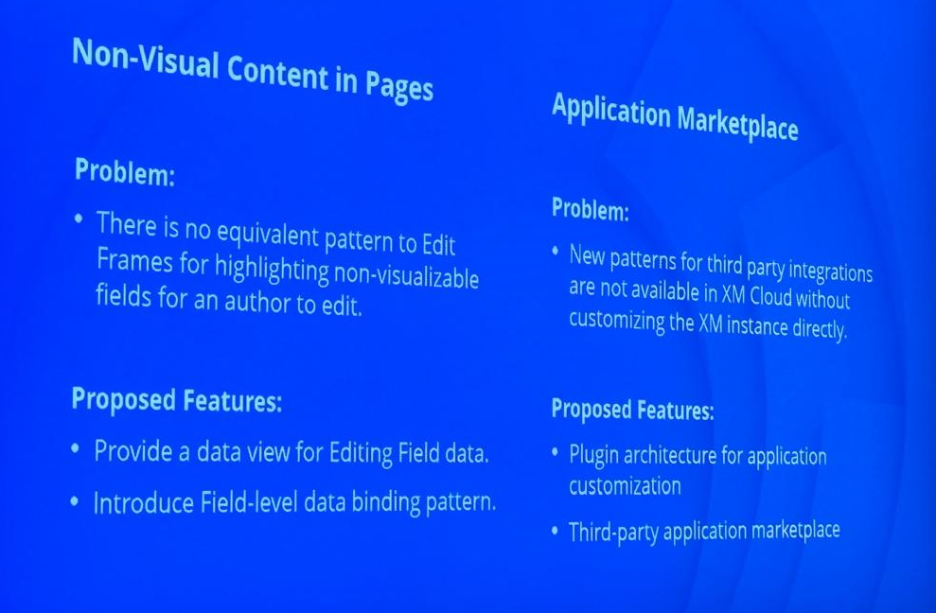
Takeaways: XM Cloud
Resolve problem of Edit Frames
Plugin architecture for application customization

Slide 24
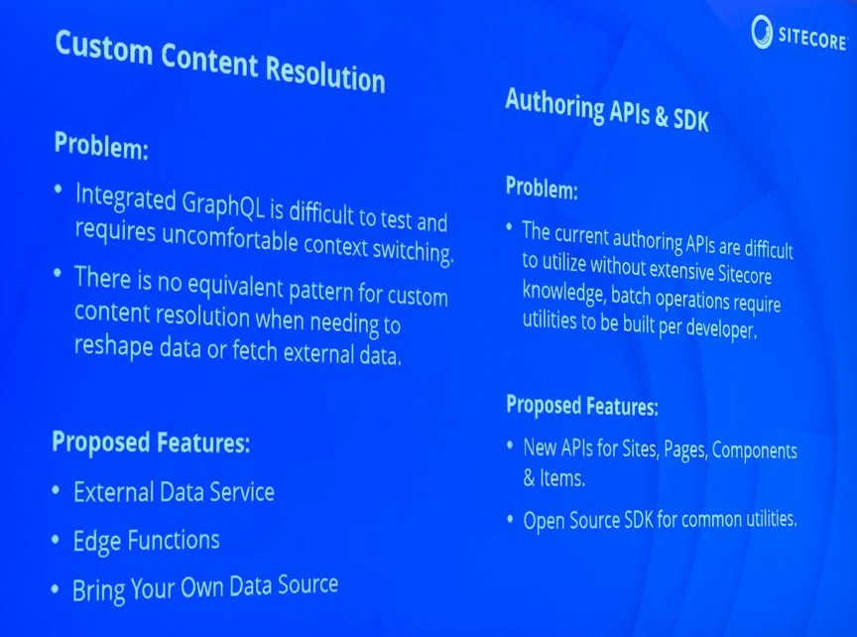
Takeaways: XM Cloud
Improve development with GraphQL
New APIs for Sites, Pages, Components and Items

Slide 25
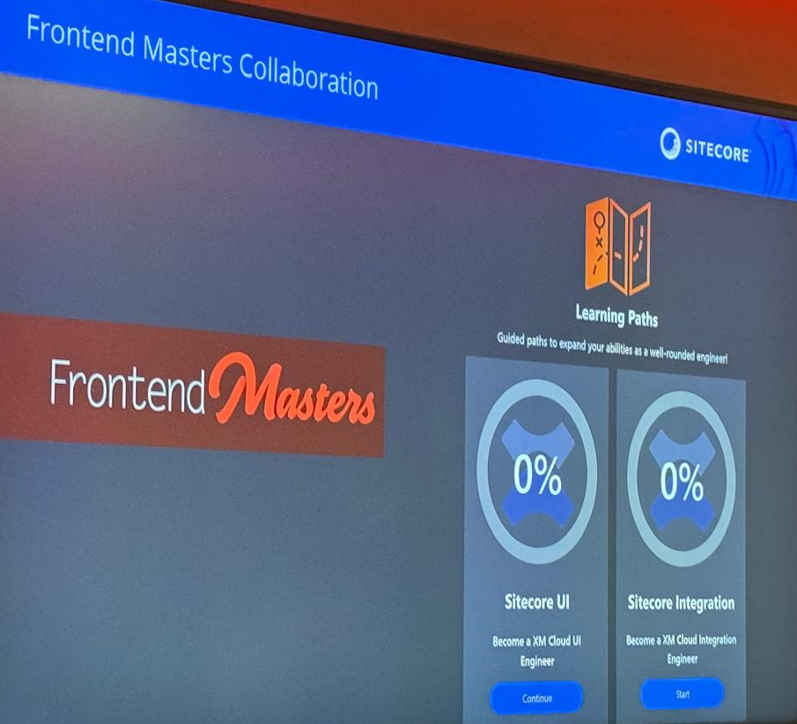
Takeaways
Course to help ‘old’ traditional Sitecore MVC developers
Also, provide training for frontend devs who are completely new to Sitecore development

Slide 26
Summary
Reduce the pain points of development
Eliminate the reliance on single framework
Single starter kit for all the frameworks

Slide 27
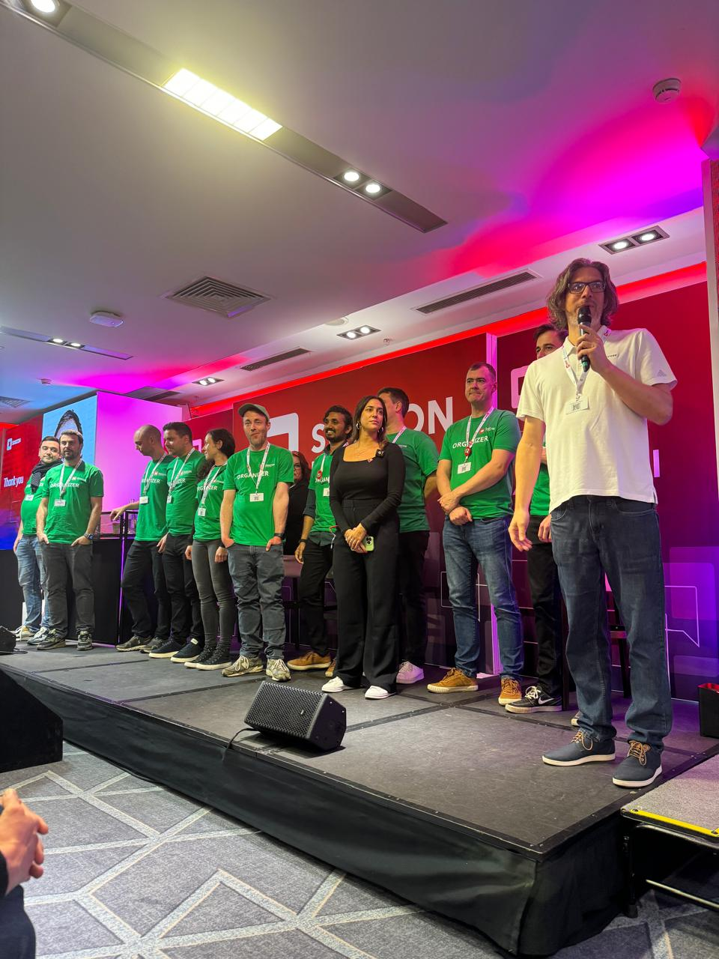
Organizers
Thank you to the organizers

Slide 28
Resources
Jason St-Cyr SUGCON Europe 2024 – Day One
Jason St-Cyr SUGCON Europe 2024 – Day Two
Sumit Upadhyay - Sitecore-sugcon-europe-2024-highlights
Dave O’Flanagan Keynote by Nabil Orfali
SUGCON YouTube Channel

Slide 29

Questions?

Slide 30
Thank you!

